Slide 1
Simulation
Stochastic modeling

Slide 2
Random objects
Random objects and base generator
Random events
Random variables
Random processes
Random point processes
BG
Transformation
α
X

Slide 3
Discrete RV
methods of generation

Slide 4
Discrete RV given by distribution
A₁
A₂
…
A_{m}
no
yes

Slide 5
Laboratory #7
Assignment:
Dice game (+cheating dice)

Slide 6
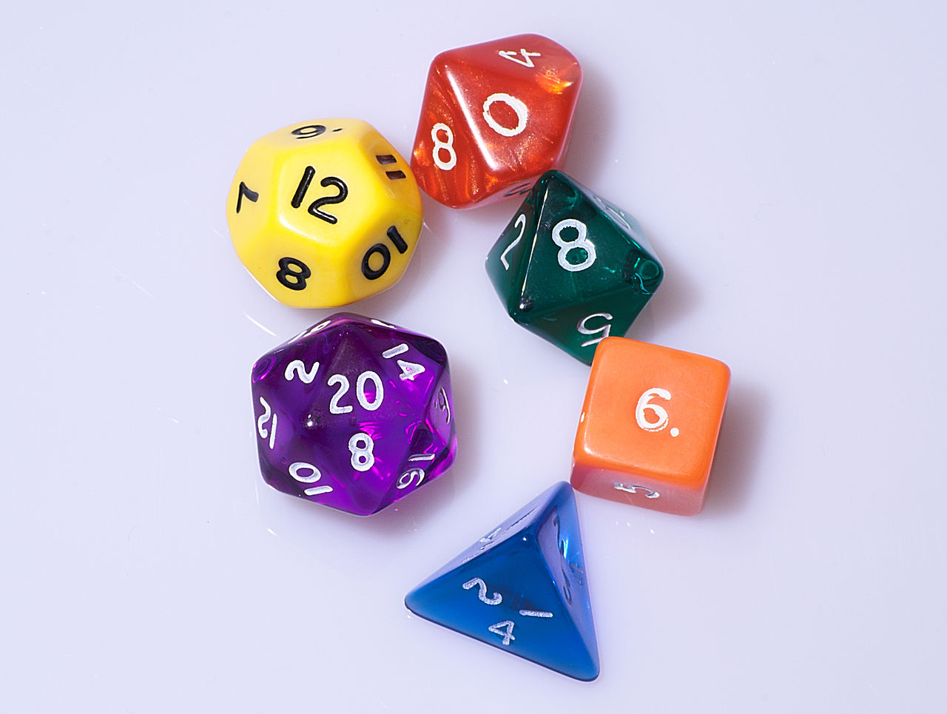
Project #B
Assignment:
Dice game (not only cubical dices!)

Slide 7
Laboratory #8
Assignment:
Stand application for various RV modeling and testing
Algorithm of user interaction:
Choose RV type
Input its parameters
Set sample volume
Do modeling
Look at probability characteristics (mean, variance, histogram)
Compare with template (analytical results)

Slide 8
Laboratory #8
list of RV to implement:
discrete
uniform
geometric
negative binomial
binomial
Poisson
continuous
exponential
given by histogram
hyper exponential
Gaussian (2 methods)
gamma

Slide 9
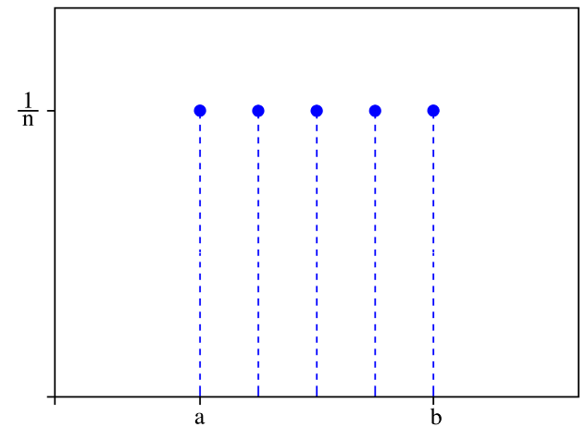
Uniform distribution
From 0 to n:
From a to b:
Int is a truncating operation
Set n = b - a
Use
Set x = x + a
For example, if x from {1, 2, .., n} then use formula:

Slide 10
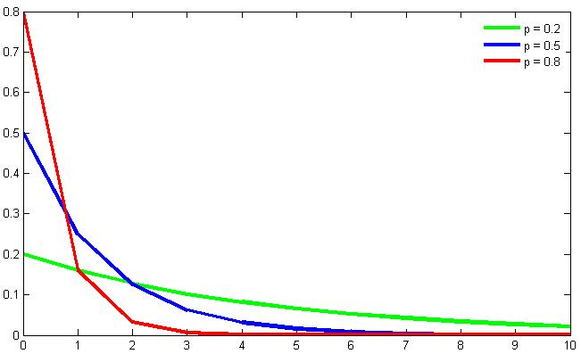
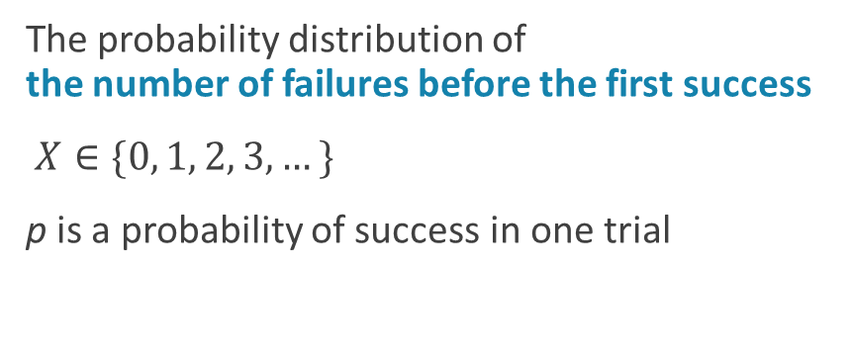
Geometric distribution
The probability distribution of the number of failures before the first success
$X∈\{0, 1, 2, 3,…\}$
p is a probability of success in one trial
generator:

Slide 11
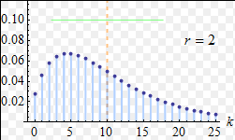
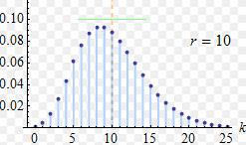
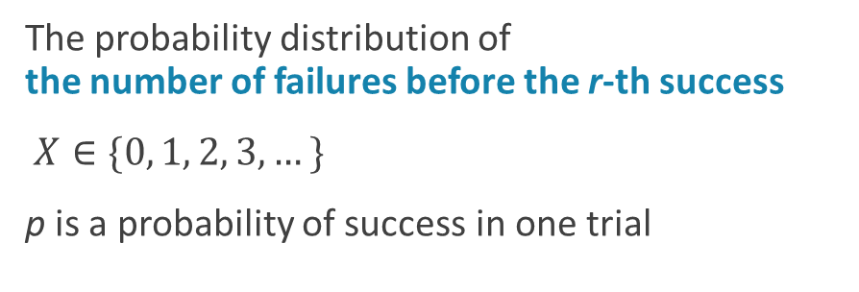
Negative binomial distribution
The probability distribution of the number of failures before the r-th success
$X∈\{0, 1, 2, 3,…\}$
p is a probability of success in one trial
generator:

Slide 12
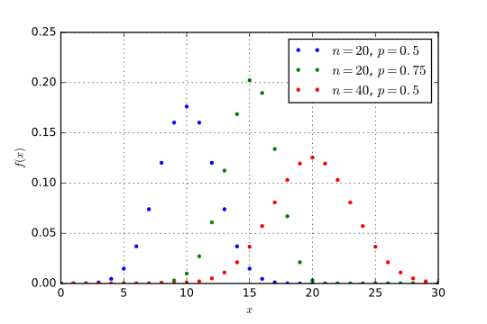
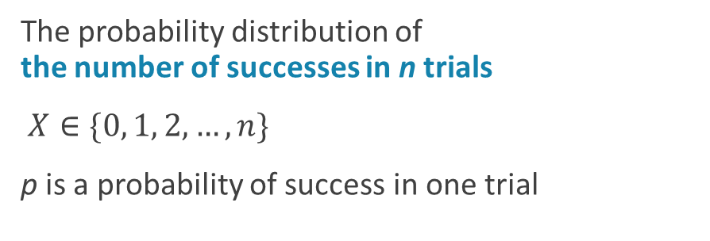
Binomial distribution
The probability distribution of the number of successes in n trials
$X∈\{0, 1, 2,…,n\}$
p is a probability of success in one trial
generator:
where
is a Heaviside step function

Slide 13
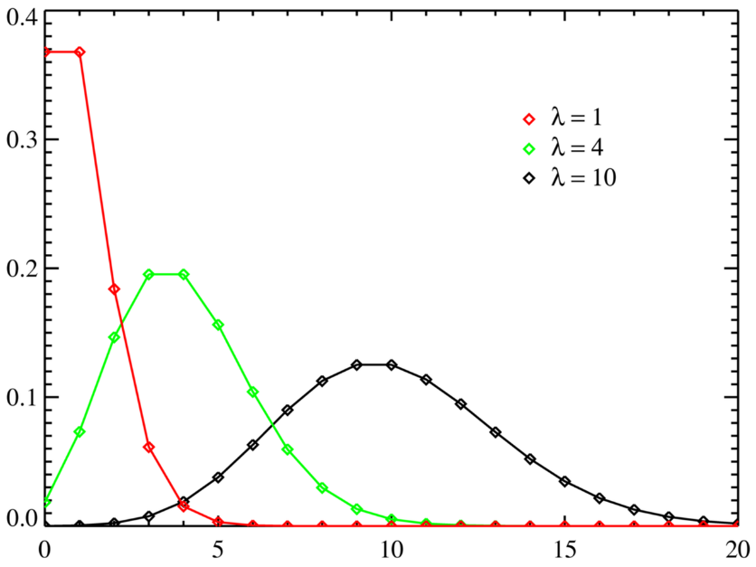
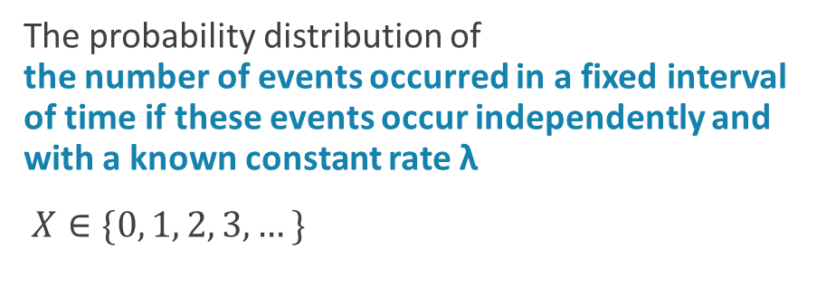
Poisson distribution
The probability distribution of the number of events occurred in a fixed interval of time if these events occur independently and with a known constant rate λ
$X∈\{0, 1, 2, 3,…\}$

Slide 14
Poisson distribution generator
no
yes

Slide 15
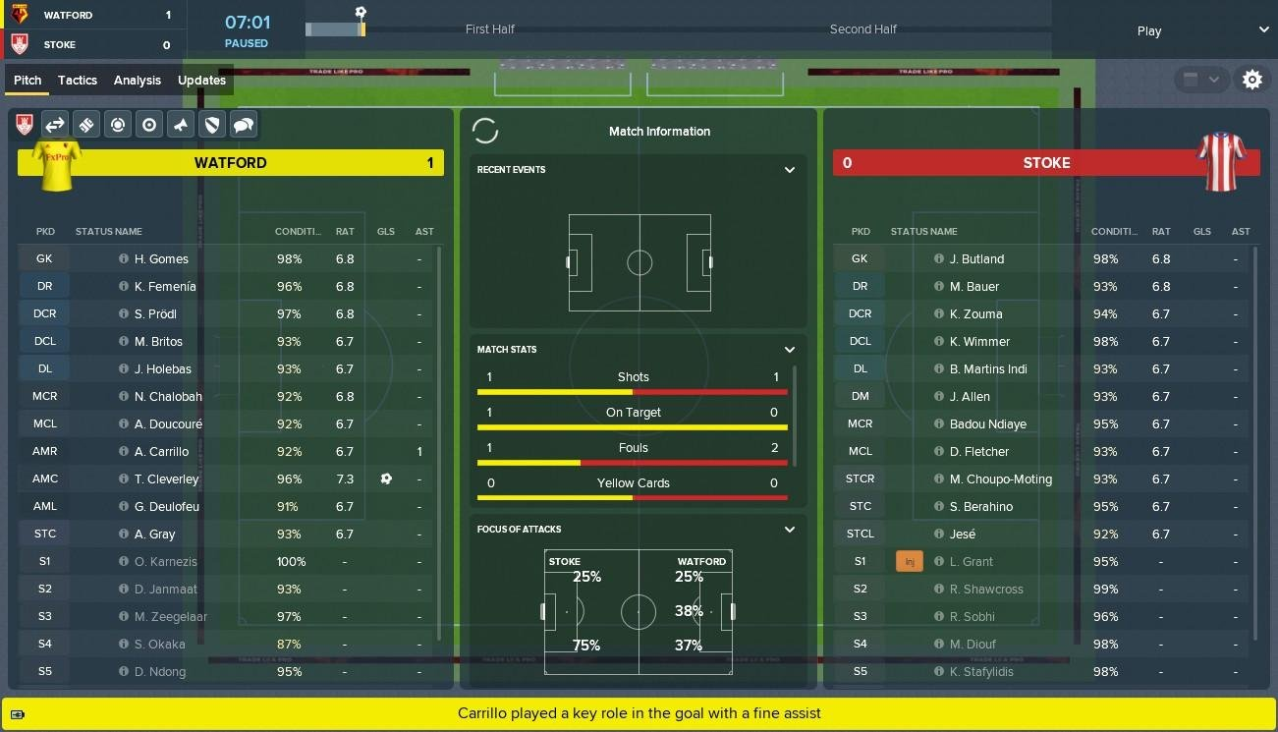
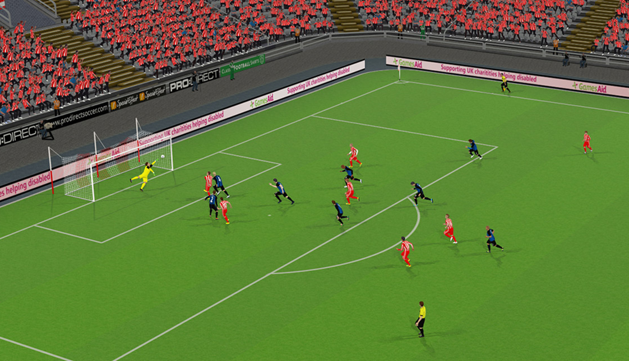
Project #C
Assignment:
Football manager game
Basketball

Slide 16
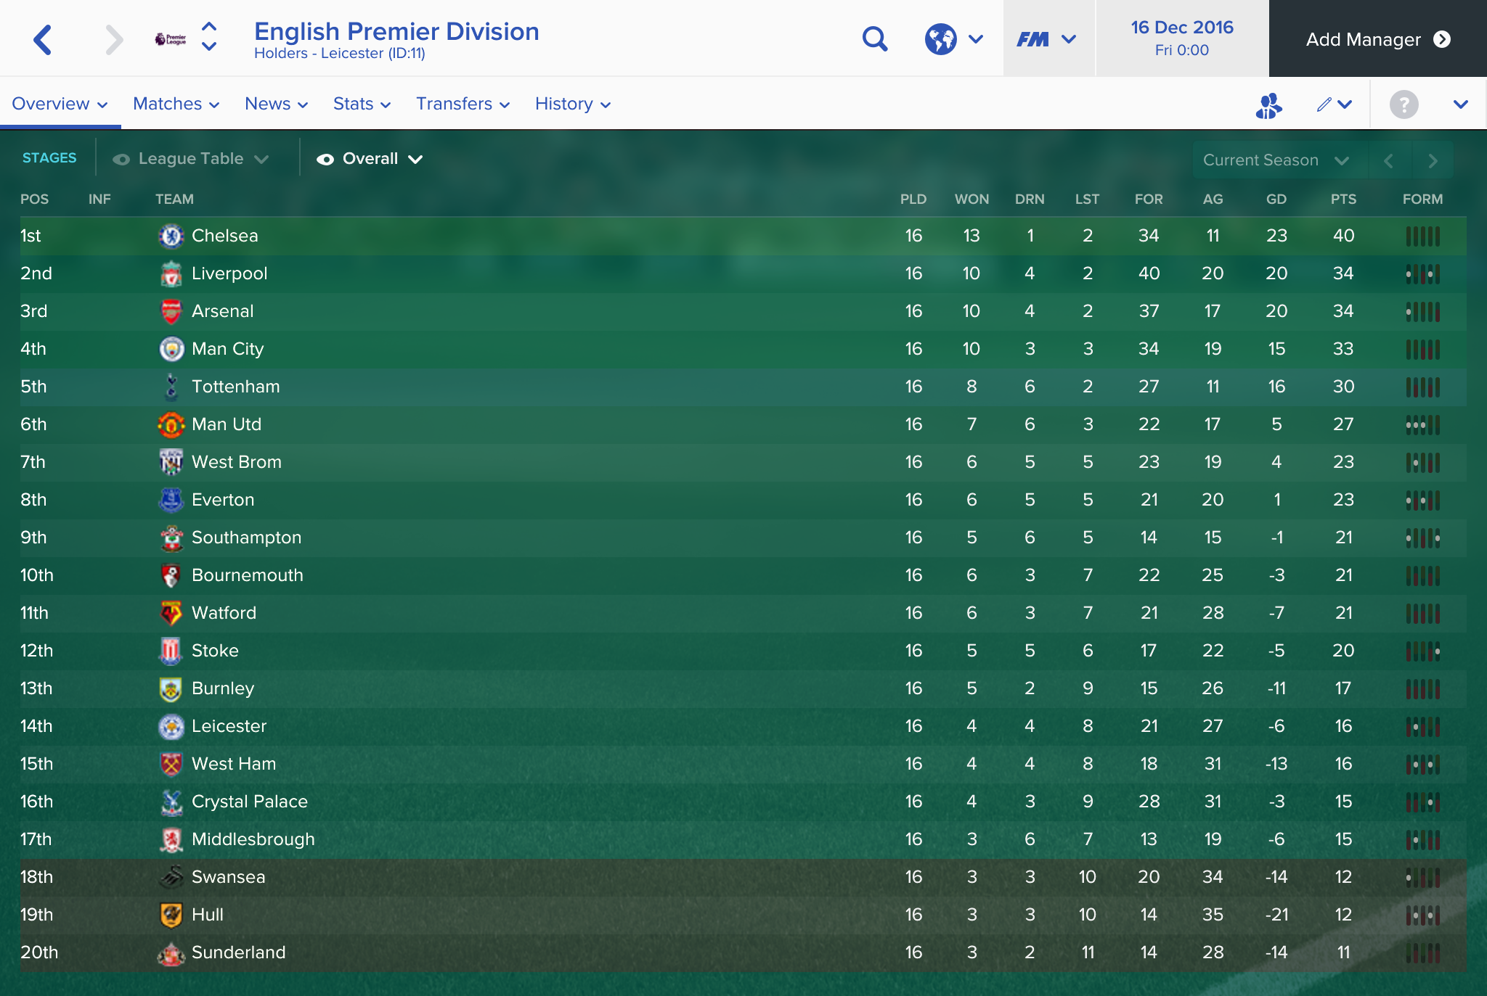
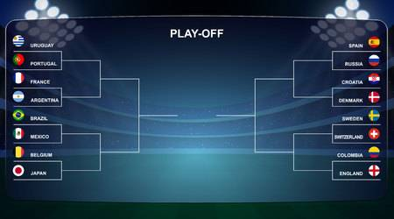
Project #C

